Slide 1
Introduction to ISO 45001
ISO 45001:2018 Occupational health and safety management systems
~ Requirements with guidance for use ~
Notes:
Key Points
House keeping
Facilities
Local Hazards
Evacuation plan
Mobile phones to silent or off
Introduce self
History in education and early childhood
Active involvement in OHS in Child Care Director and Regional Coordinator roles
Started second career in injury management / OHS in the Justice Portfolio (Attorney General’s Department)
Several years in DPTI
Pretend retirement in 2014
Subsequent contract work at;
SA Health & Medical Research Institute
ASC Training & Development (HSR training)
Courts Administration Authority
HydroPlan
Small winery audits
Keen SCUBA diver with professional qualifications
Been exposed to most types of health and safety risks in both my personal and professional life.

Slide 2
Session Outline
About us
About standards
Current OHS standards – Specs and principles / guidance
What’s new with ISO 45001:2018?
Australian context
UK implementation as an example
Making the transition
Summary and Feedback
Notes:
Key Points
Session in 3 parts
1st part addresses duties of care and specific hazard management responsibilities under the WHS legislative framework
2nd part provides an overview of HIRM and how this reflects the hazard management approach in the “How to Manage Work Health and Safety Risks” Code of Practice
3rd part provides time and space to work through practical return to work strategies, with a focus on psychological factors (e.g. occupational threats/violence; conflict; workload etc)
This section is not just about staff who have active workers compensation claims, but is also about those who are attempting to manage within their own resources and leave provisions.

Slide 3
About Us
Professional Networks
WHS Consulting
First Aid Training
SCUBA Instruction
ASC Training and Development
WHS & HSR Training
HEALTH
SAFETY
Clients
WELLBEING
Notes:
Key Points
Session in 3 parts
1st part addresses duties of care and specific hazard management responsibilities under the WHS legislative framework
2nd part provides an overview of HIRM and how this reflects the hazard management approach in the “How to Manage Work Health and Safety Risks” Code of Practice
3rd part provides time and space to work through practical return to work strategies, with a focus on psychological factors (e.g. occupational threats/violence; conflict; workload etc)
This section is not just about staff who have active workers compensation claims, but is also about those who are attempting to manage within their own resources and leave provisions.

Slide 4
About Standards (1)
“Standards Australia develops internationally aligned Australian Standards® in the national interest through a process of consensus.”
Source: www.standards.org.au
Notes:
Key Points
Item
Examples
Item
References
Item

Slide 5
About Standards (2)
“Standards are voluntary documents that set out specifications, procedures and guidelines that aim to ensure products, services, and systems are safe, consistent, and reliable.” Source: www.standards.org.au
Notes:
Key Points
Item
Examples
Item
References
Item

Slide 6
About Standards (3)
Source: www.standards.org.au
Notes:
Key Points
Item
Examples
Item
References
Item

Slide 7
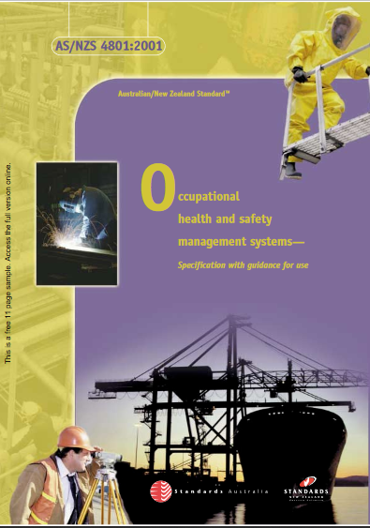
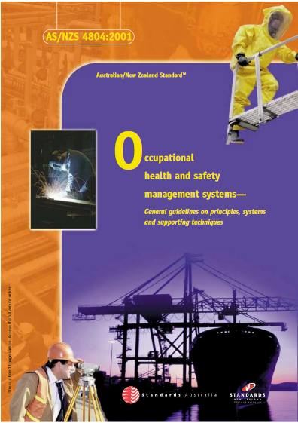
Standards – Specifications & Guidance
Notes:
Key Points
Item
Examples
Item
References
Item

Slide 8
Standards – Specs & Guidance: Examples
SPEC^{S} 4801 – Communication
The organisation shall have procedures for ensuring that pertinent OHS information is communicated to and from employees and other interested parties.
(Section 4.4.3.2)
Guidelines 4804 – Communication
Multiple references in relation to leadership, resources, management etc, PLUS
Meetings.
Team briefings.
Hard copy or electronic mail.
Videos.
Bulletins
Noticeboards.
Newsletters.
Signage.
Notes:
Key Points
Item
Examples
Item
References
Item

Slide 9
Standards – Specs & Guidance: Examples
Commonly used methods of external communication include:
(i) Annual reports.
(ii) Publications.
(iii) Inserts in industry publications.
(iv) Paid advertising.
(v) Telephone inquiry services.
(vi) Submissions to government on changes to legislation.
4804:2001 ~ Section 4.3.3.1
…and there’s more!
Notes:
Key Points
Item
Examples
Item
References
Item

Slide 10
What About ISO 45001?
Contextualised
Principles / Systems / Techniques / Guidance
ISO/PC 283
(international technical committee)
Standards Australia: Technical committee SF-001
Pending
SATC SF-001
Other member nation’s tech committees
Contextualised
British Standards Institution
BS 45002-0:2018
This Photo by Unknown Author is licensed under CC BY-SA
Notes:
Key Points
Item
Examples
Item
References
Item

Slide 11
Australian & New Zealand Contributors
Contributors to Australia’s position on the draft ISO 45001 include:
Association of Accredited Certification Bodies
Australian Chamber of Commerce and Industry
Australian Council of Trade Unions
Australian Industry Group
Bureau of Steel Manufacturers of Australia
Department of Natural Resources and Mines, QLD
Energy Networks Australia
Engineers Australia
Joint Accreditation System of Aust. & NZ
Master Builders Australia
New Zealand Institute of Safety Management
Responsible Care New Zealand
Safe Work Australia
Safety Institute of Australia
Australian Certification Interests (SAI Global)
University of New South Wales
Notes:
Key Points
Key roles and responsibilities
“Duty Holders”
“Duties of Care” and
the “Standard” to which duties must be exercised
The Act & Regs have many context – specific responsibilities.
Section 19 of the Act and Regulations 32 – 38 are the key underpinning responsibilities.

Slide 12
Legislation and Standards
Legislation
Legislation
…or
+
…including Standards
Standards
Notes:
Key Points
Item
Examples
Item
References
Item

Slide 13
Current Status
“AS/NZS 4801-2001 – Occupational health and safety management systems - Specification with guidance for use” remains the current voluntary standard used in Australia, until Standards Australia’s Technical Committee … evaluate the final version of ISO 45001 against the existing AS 4801 standard … in the context of Australia’s legislative and business environment.
Source: www.sia.org.au
Notes:
Key Points
Item
Examples
Item
References
Item

Slide 14
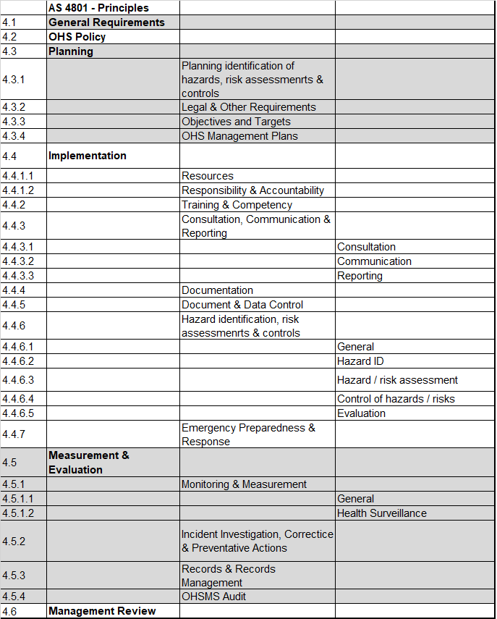
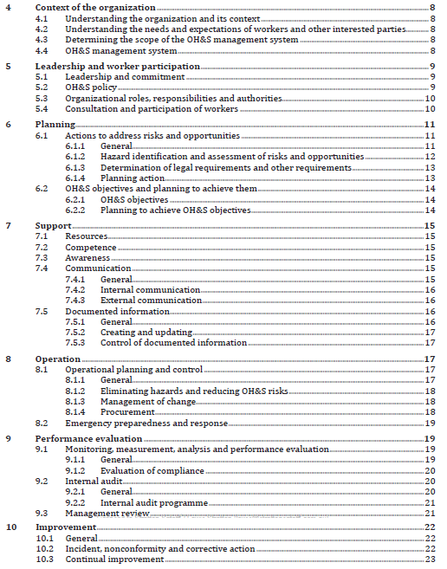
ISO 45001 >>
Notes:
Key Points
Item
Examples
Item
References
Item

Slide 15
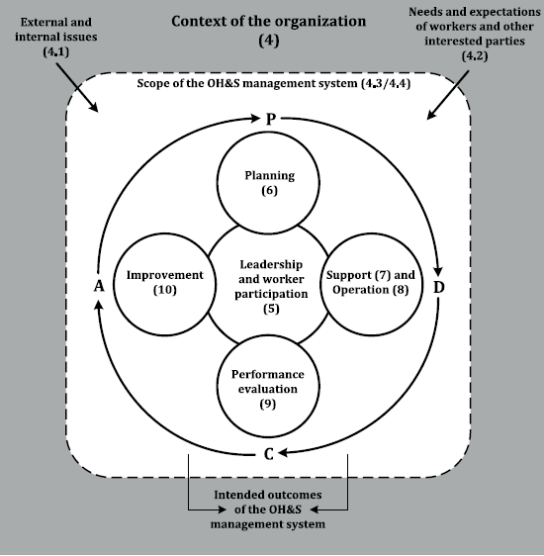
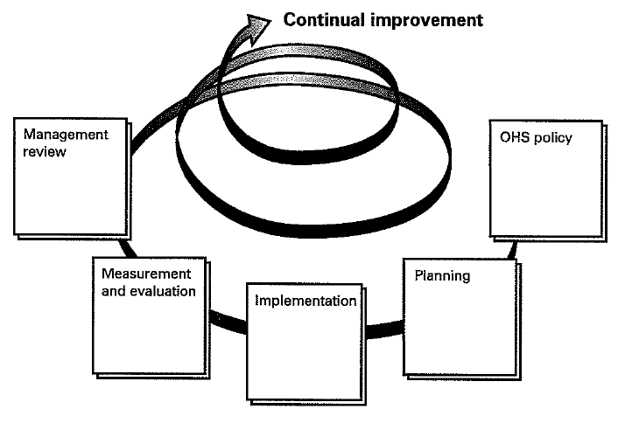
Transitions (1)
Notes:
Key Points
Item
Examples
Item
References
Item

Slide 16
Transitions (2)
ISO 45001
Greater emphasis on systematic and proactive
No Injury Management
Definition of Incidents
Health and safety focus
Property damage
Continual improvement
systems & outcomes
Clearer sense of continuous improvement – not all elements all of the time
Legislative links
Multiple businesses
+
Notes:
Key Points
Item
Examples
Item
References
Item

Slide 17
United Kingdom – BS 45002-0:2018
Increased clarity / expectation with regard to;
Organisational context
Leadership commitment
Worker participation (i.e. leadership ensuring participation)
Recognition of electronic and paper based records
Expectation that risk assessments will be subject to review
Re-inclusion of “isolation” in HOC (i.e. “reduce exposure”)
Safe systems supporting viability / profitability
Notes:
Key Points
Item
Examples
Item
References
Item

Slide 18
Australia and ISO 45001?
Standards Australia Technical Committee contextualising work
Business group caution about proceeding
Fear of resource implications?
Implications for building standards?
Who will drive the transition?
Implications for standards compliant organisations
Mastery of 4801 / 18001 ≈ manageable adjustment to 45001
Non-compliant 4801 / 18001 ≈ non-compliant 45001
Notes:
Key Points
Item
Examples
Item
References
Item

Slide 19
Notes:
Key Points
Item
Examples
Item
References
Item

Slide 20
Session Summary
Notes:
Key Points
Item
Examples
Item
References
Item

Slide 21
About Stratton Safety
Director: Lewis Stratton
Email: lewis@strattonsafety.com.au
Web: www.strattonsafety.com.au
Mob: 0405 321 874
Services
Policies, procedures, SOPs, risk assessments, workplace inspections, internal / external / certification audits, training, investigations and all things health and safety!
Notes:
Key Points
Item
Examples
Item
References
Item

